Slide 1
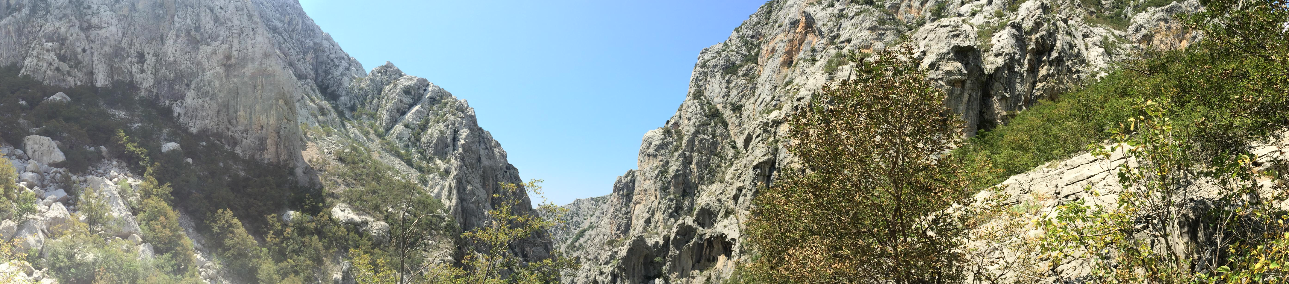

OGC vs Open/Linked data
Benefits of working in a highly standardised community
Paul van Genuchten, Maria Arias de Reyna

Slide 2
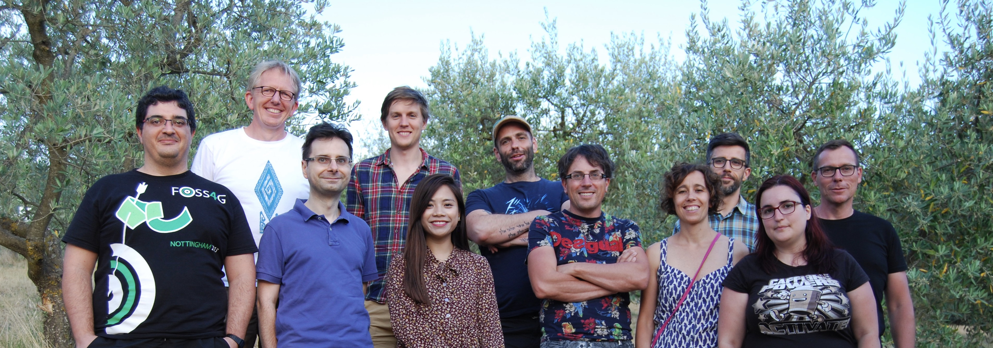

GeoCAT
Currently 11 staff, based in NL and ES
Founder of GeoNetwork
Offering services on the OSGeo Stack
GeoNetwork GeoServer PostGIS QGIS …

Slide 3
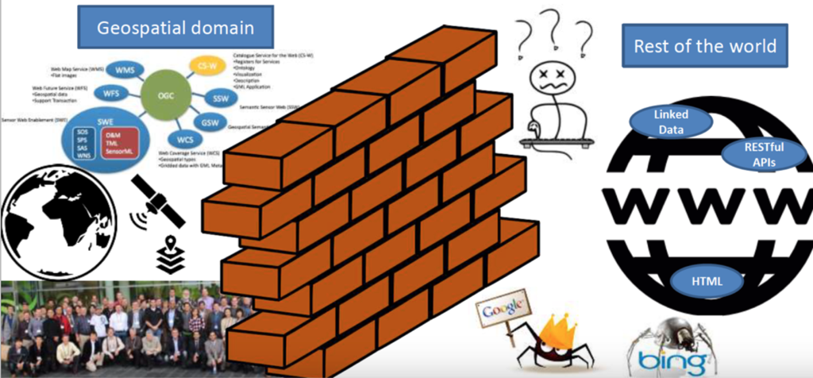
Notes:
Picture by LindavdB Geonovum
A general conception in the spatial community

Slide 4
RDF, OWL, DCAT, VOID, SPARQL, TTL, DBPedia, SSN
Html, URL, microdata, json-ld, RDFa, Schema.org, OpenGraph
GeoJson, TopoJson, VectorTiles, TMS
OKFN, DataPackage, CSV
OData
stat-dcat
Notes:
But there is not such a thing as the others, there are many types of others

Slide 5
Interfaces between communities is important
And then it helps if the community is highly standardised

Slide 6
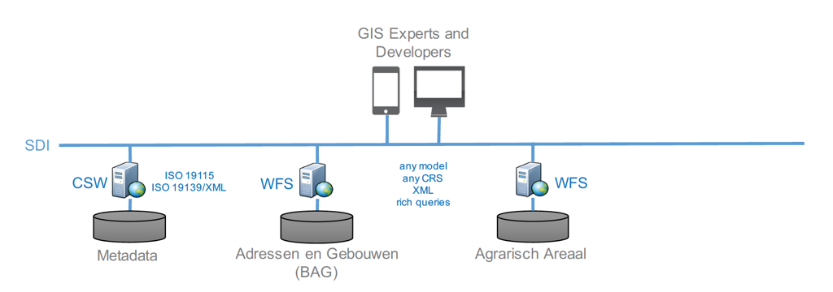
Example of Proxy approach
Notes:
Current typical sdi

Slide 7
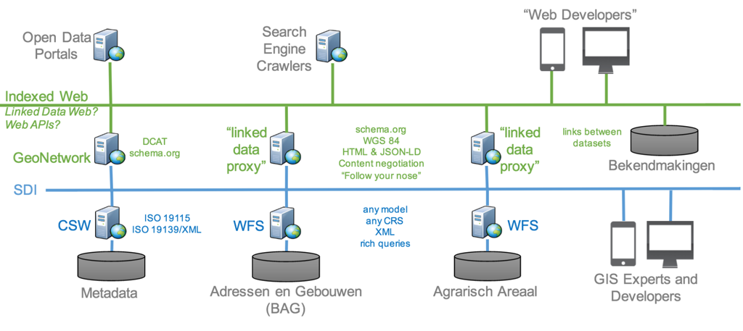
Notes:
Sdi with proxy approach

Slide 8
However...
Some universal rules all communities should adopt
Use (resolvable) URI’s to identify things
Records in a database (exposed via WFS)
Metadata in a catalogue
References to codelist items
Re-use ontologies and codelists where possible

Slide 9
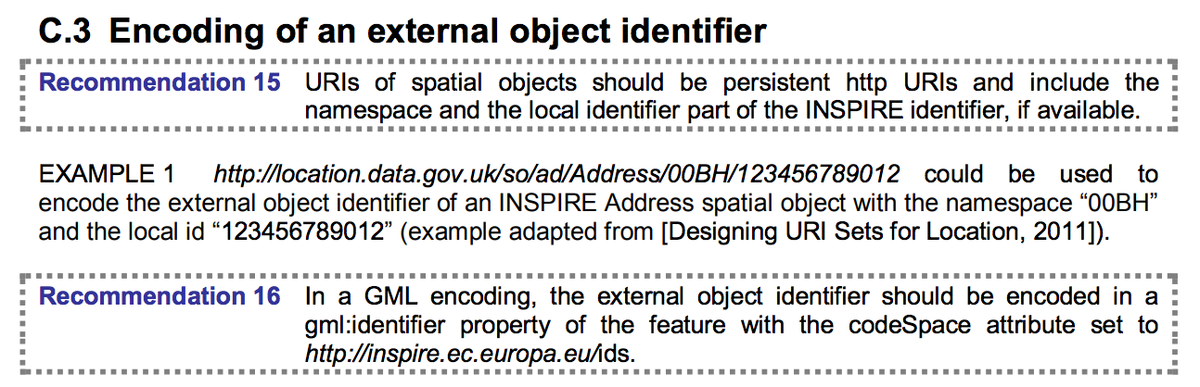
INSPIRE helps OUT

Slide 10
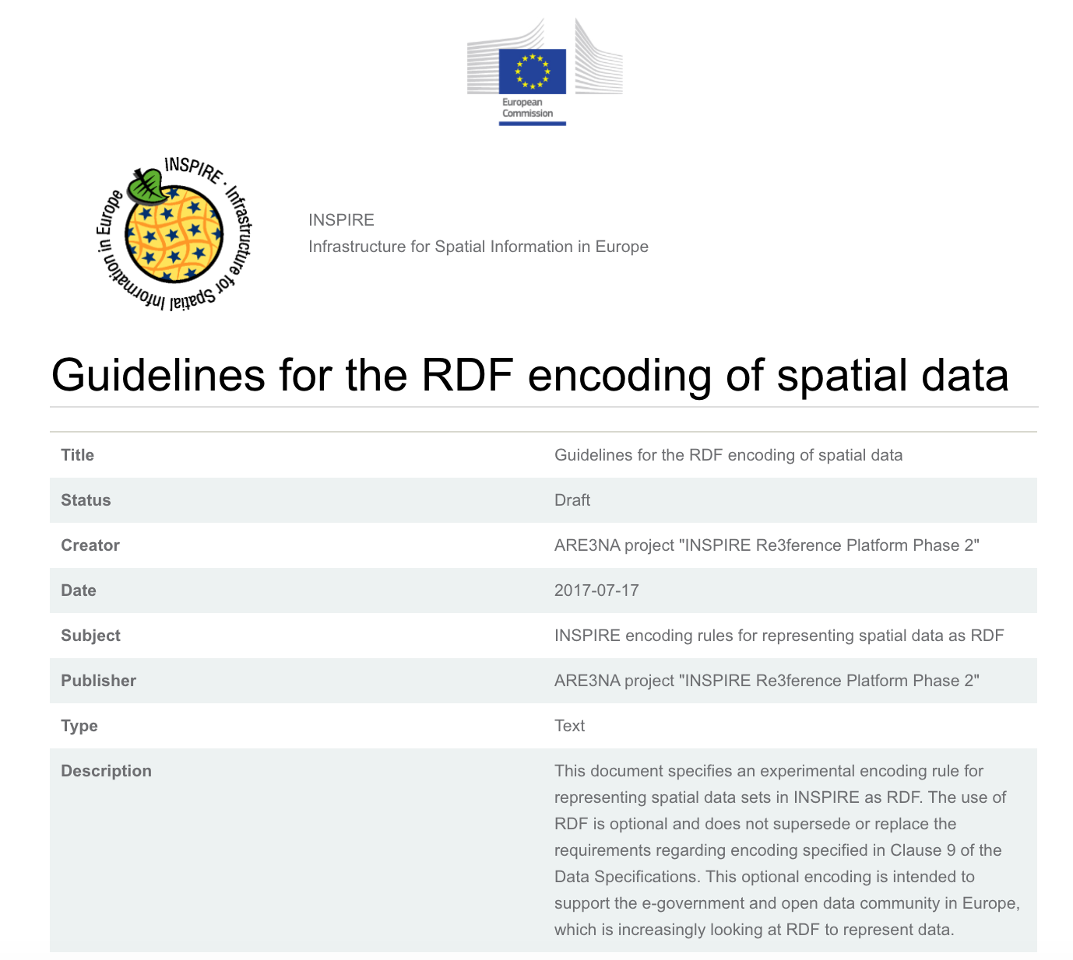
INSPIRE in RDF
http://inspire-eu-rdf.github.io/inspire-rdf-guidelines/

Slide 11
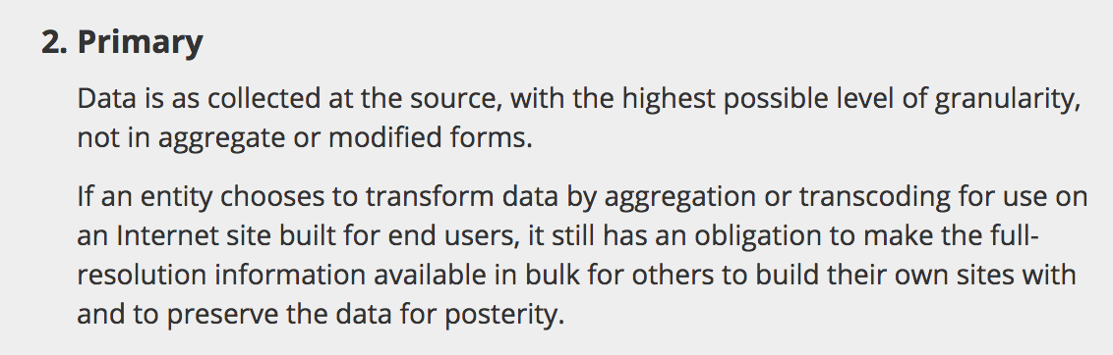
transformation vs annotation
INSPIRE Dataset
Dataset
INSPIRE Annotations
Dataset

Slide 12
Some use cases
of bridging the communities and the standards help out

Slide 13
Spatial Metadata via open data portals
Requires a transformation from iso19139 to DCAT
May need alternative protocols then CSW
Challenges
If multiple portals are crawled by search engines, you may end up with multiple hits of the same dataset in the search engine
WMS/WFS protocol links are not common in open data portals
Notes:
Maybe we can add some use cases here?

Slide 14
Locate WFS/CSW features via search engines
Have a webpage created for every WFS/CSW-record
Use schema.org annotations to have the search engine crawl the content as structured data
Provide value to end-users who are finding your records on the search engines

Slide 15
Query spatial (meta)
data as RDF (SPARQL)
- Expose WFS as RDF
All watercourses, crossing a road network, 2500m around my current location, having had maintenance activity last month.

Slide 16
Simple query API on WFS
Targets the API developer community

Slide 17
RDF data as GIS layer
a sparql query as a base for a WFS feature type definition?

Slide 18
Future in Linked data?
OGC and INSPIRE are looking at linked data
joined effort of OGC and W3C

Slide 19
A potential direction
In dataset registration process add metadata about the datamodel
Use the data model metadata to harmonise the data

Slide 20
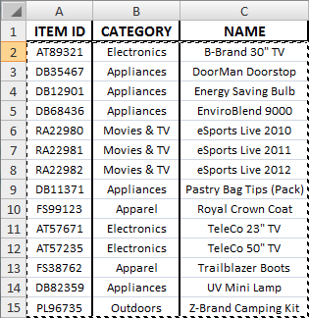
Create RDF from table data
Featuretype is type
schema.org/Product
Mint a URI based on unique column
schema.org/identifier
Link columns to concepts from common ontologies
schema.org/name
Notes:
This explains an easy way to create pdf, the principle, wuite some tools do it in this way, like ldproxy, d2rq, fiona

Slide 21
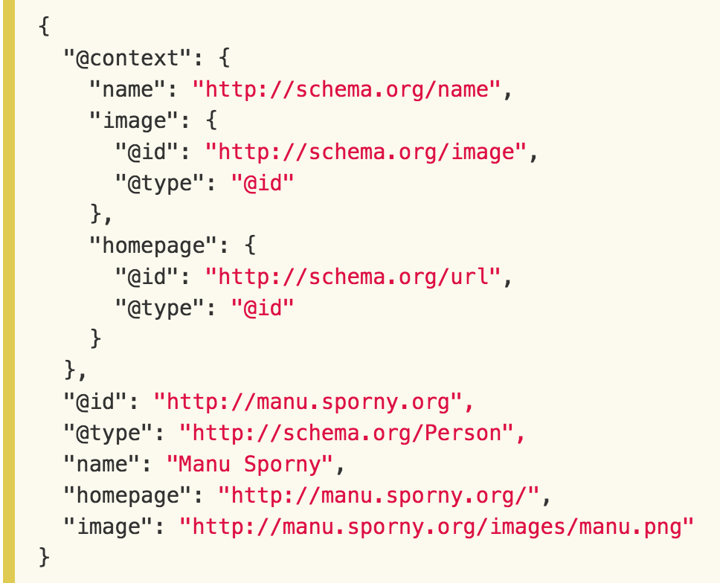

Slide 22
Feature catalog metadata
ISO19110 is a TC211 standard to describe the data model of a dataset.
Indicate the featuretype each record represents
For each column describe a label and a link to a concept in an ontology

Slide 23
Conclusions
A lot of work has been done on Inspire & RDF
Is RDF a good alternative besides XML or is it the only-way-forward?
The fact that we’re already a highly standardised community helps

Slide 24
We hope to hear your comments
info@geocat.net

